Slide 1
Travelling Salesman Problem
an unfinished story...

Slide 2
Contents
Description of the problem
History
Sample Algorithms
Performance Comparison
TSP with Parallel Computing
Conclusion

Slide 3
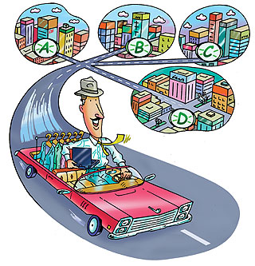
Description of the Problem
Given a number of cities and the costs of travelling from any city to any other city, what is the least-cost round-trip route that visits each city exactly once and then returns to the starting city?

Slide 4
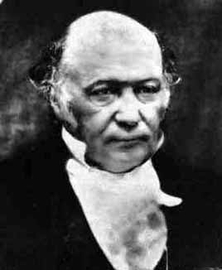
History
The origins of the travelling salesman problem are unclear. A handbook for travelling salesmen from 1832 mentions the problem and includes example tours through Germany and Switzerland, but contains no mathematical treatment.

Slide 5
Sample Algorithms
Constructive Heuristics
Nearest Neighbour (Greedy)
Insertion Heuristics
2-OPT
3-OPT
Genetic Algoritms
Simulated Annealing
Neural Network

Slide 6
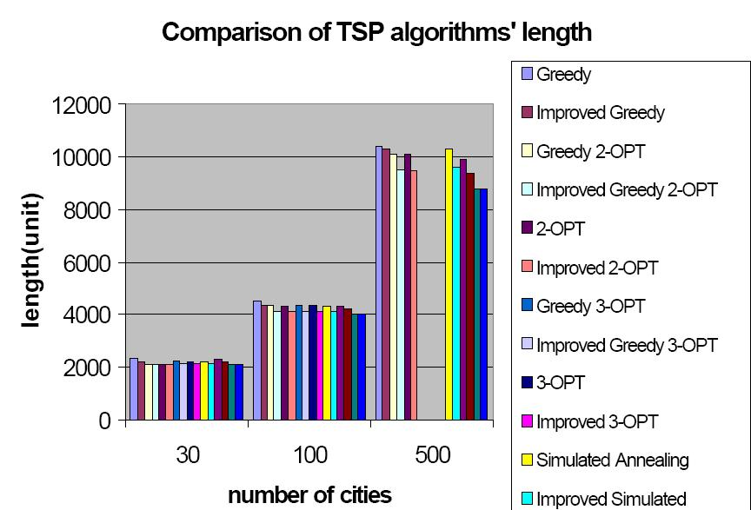
Performance Comparison

Slide 7
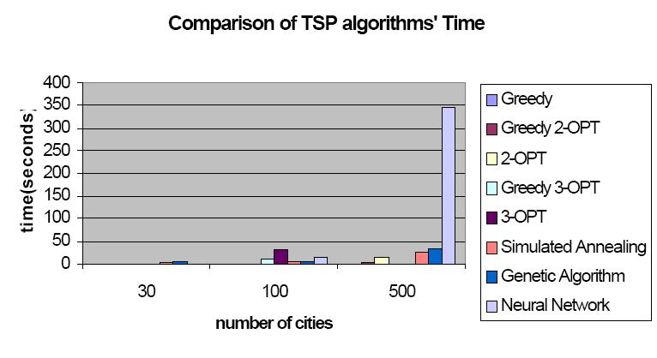
Performance Comparison
continued...

Slide 8
TSP with Parallel Computing
Time (sec.)
N_{P}

Slide 9
TSP with Parallel Computing

Slide 10
TSP with Parallel Computing

Slide 11
TSP with Parallel Computing

Slide 12
Conclusion
For small-size TSP (n < 50), improved greedy 2-opt algorithm is recommended.
For medium-size TSP ( 50 < n < 100), improved 2-opt algorithm and neural network are recommended for their optimality and efficiency.
For large-size problem (100 < n < 500), the improved genetic algorithm is recommended.
For any problem-size, if the computational time is not a constraint, the improved neural network is always recommended.

